Slide 1
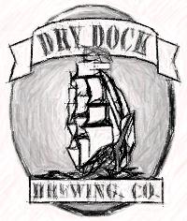
Dry Dock Brewing Co.
&
The Rapid Increase of
Small Breweries in Colorado
Technical Meeting
MBAA-Rocky Mountain District
Wednesday, August 10th, 2011
Kevin DeLange
Owner/Founder
Dry Dock Brewing Company

Slide 2
Homebrew Roots
Started homebrewing at age 21 in 1995
Quit corporate job in 2002 and purchased The Brew Hut
One man shop
Increased inventory and products
30% annual growth
Foundation for recipe development and troubleshooting
Developed relationship with vendors and commercial brewers
Notes:
Bored after a year

Slide 3
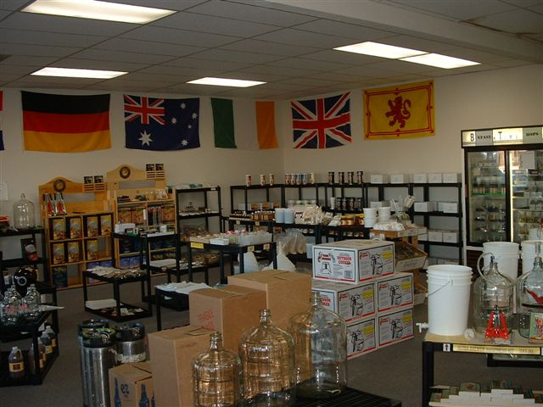

Slide 4
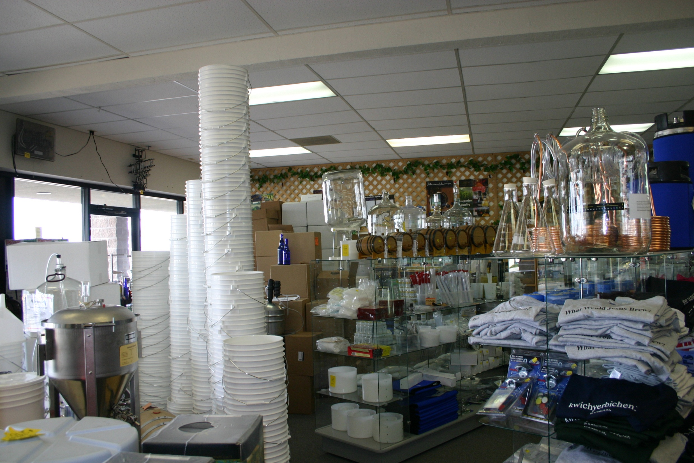

Slide 5
Craft Brewing and the Search for
“Pots and Pans”
Opened Dry Dock in 2005
800 sq. foot space next door to The Brew Hut was vacant
Called breweries around Colorado for equipment
Matt Vincent from Ska found 7bbl system from Palisade Brewing
Tanks from Only The Best in Divide, CO
John Hanley at Rock Bottom helped with pump, valves, lines, grant, etc.
Installed hot water on demand system to save space

Slide 6
Getting Open:
Twice as expensive… Twice as long…
  Equipment - $30,000 (cooler, bar and hot water on demand)
  800 sq. ft brewery build out - $50,000
    $62.50/sq. foot
  Other $45,000 of startup costs
    Legal fees
    Licensing
    Insurance
    Rent during construction
    Architects and plans
    Working capital (Glassware, ingredients, chemicals)
  Total initial investment = $125,000

Slide 7
Finally open
Seating for 35
7bbl “Pots and Pans”
2 – 7bbl single-walled stretched Grundy fermenters
  Used “Cold Room” for temperature control
1 – 7bbl single-walled Grundy as brite tank
Served out of kegs
Maximum production was 400 barrels/year
1st purchases
  Keg washer
  Serving tanks

Slide 8
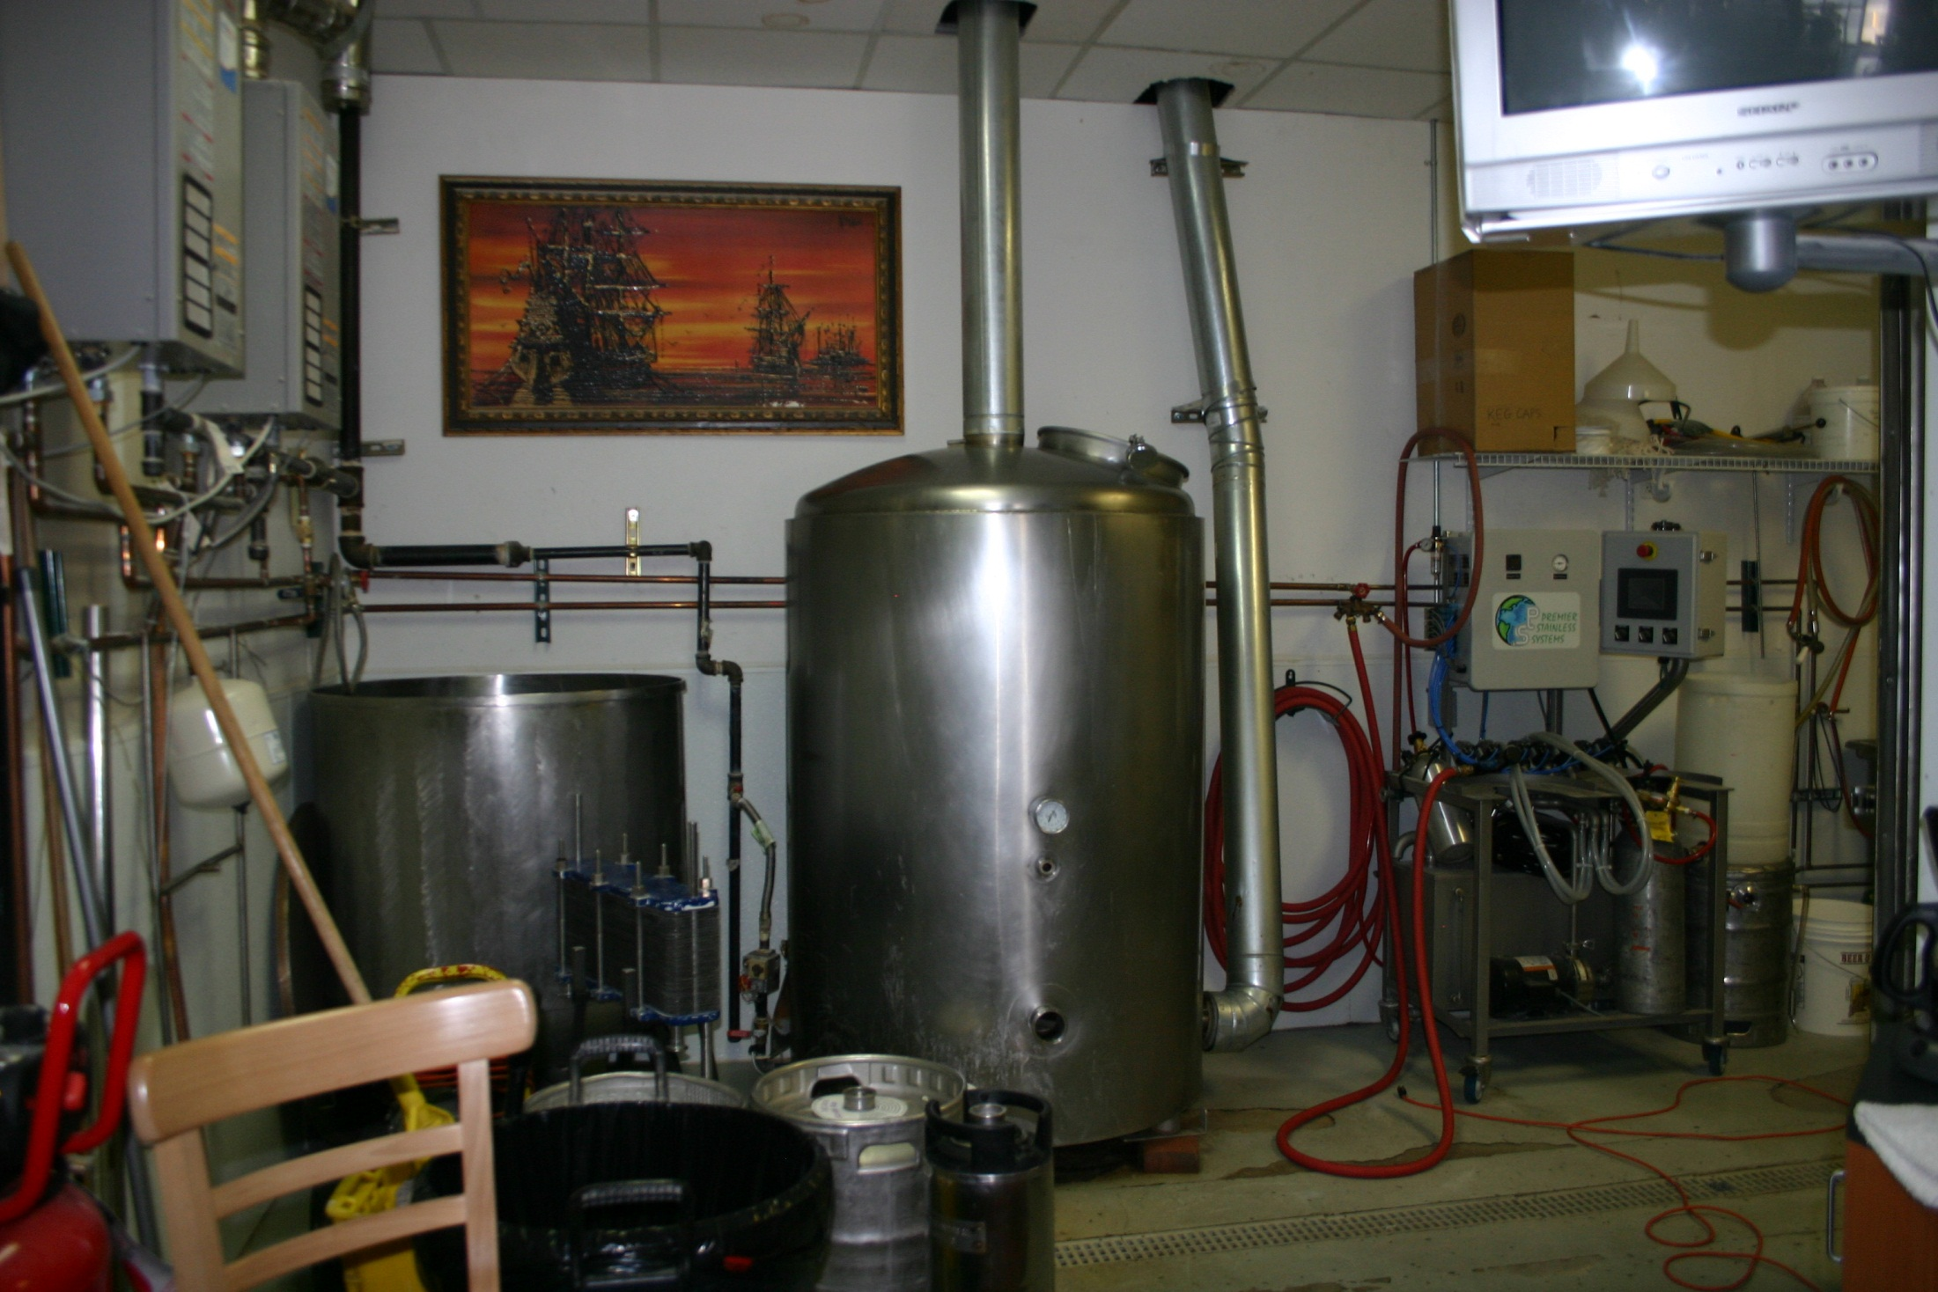

Slide 9
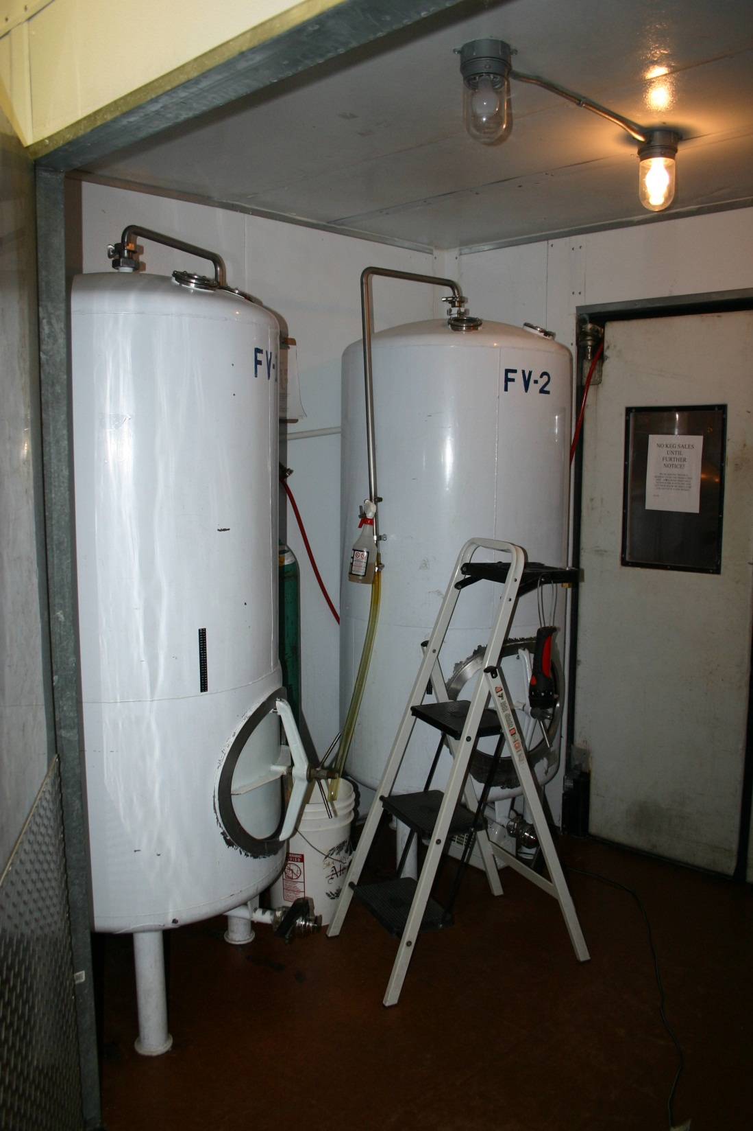

Slide 10
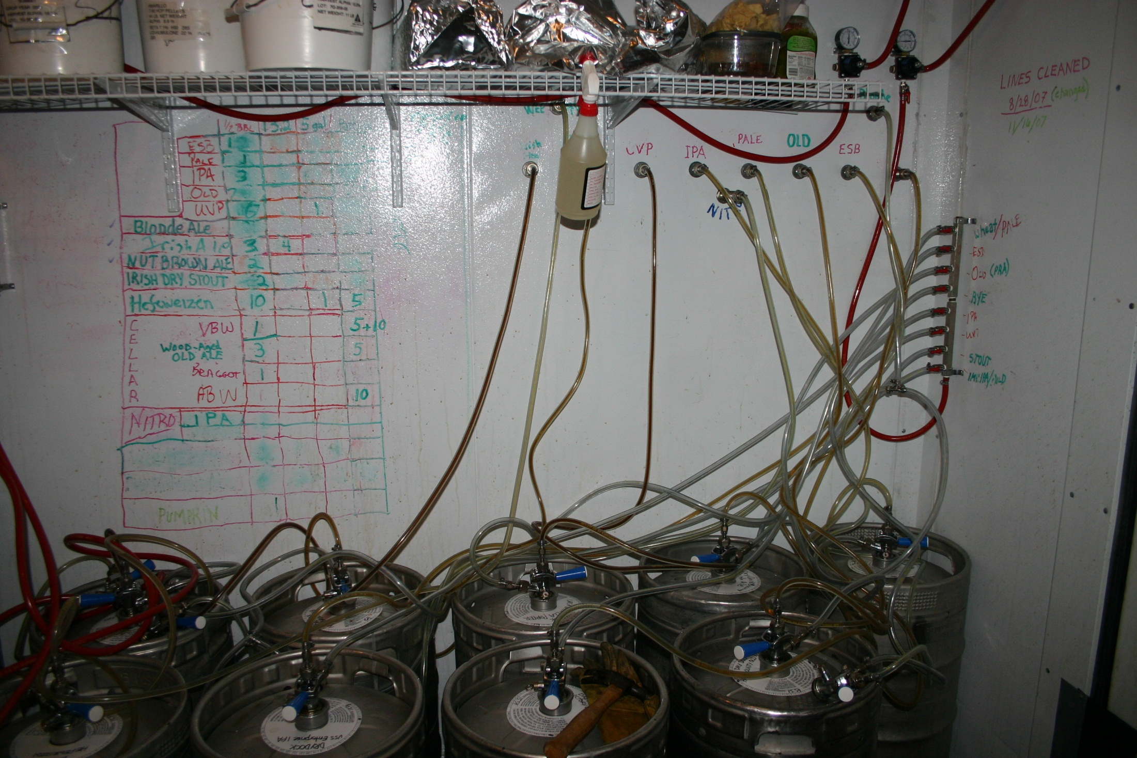

Slide 11
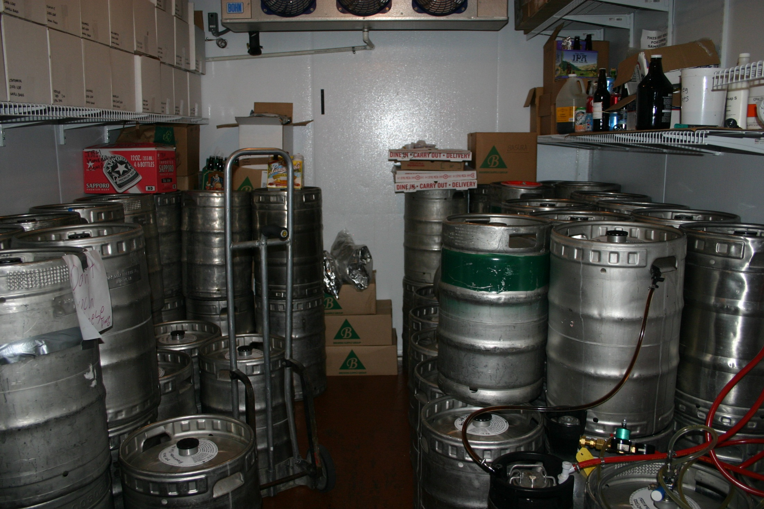

Slide 12
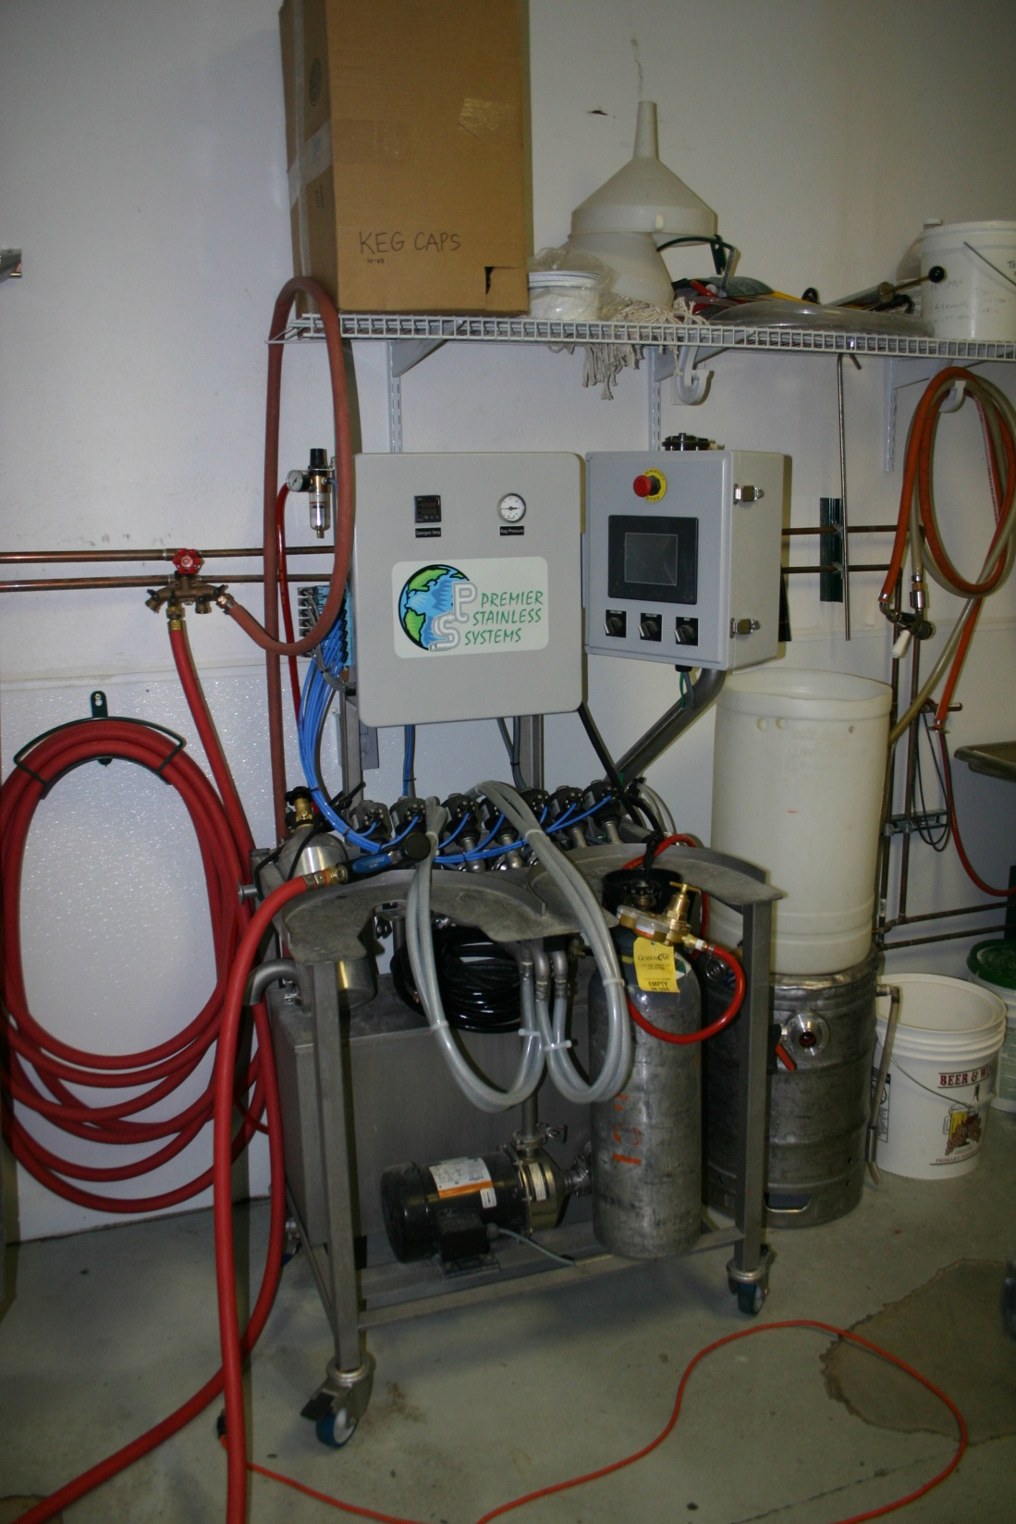

Slide 13
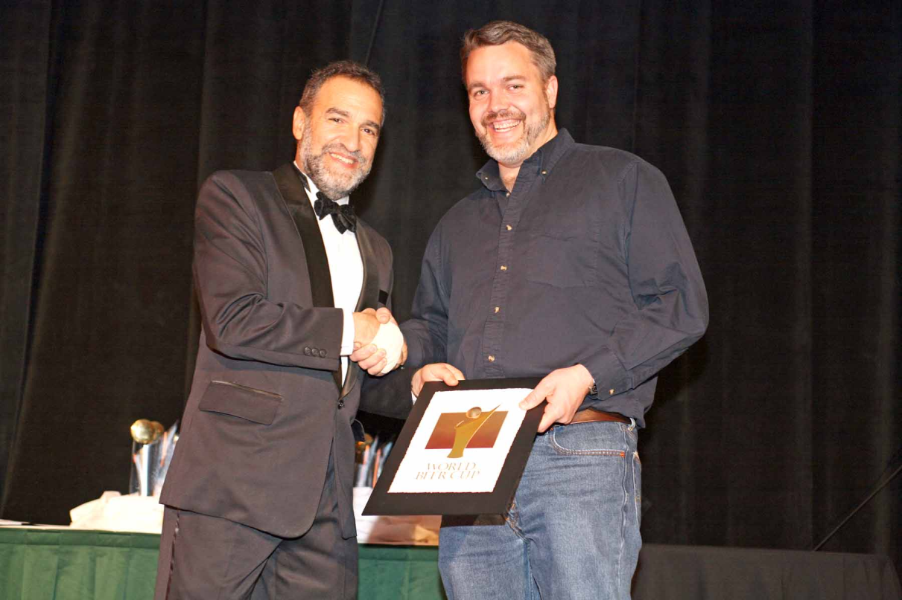
The Early Years
What was I thinking?!?
  Doing it all
  Very low revenue
2006 World Beer Cup – Gold for ESB
  Lots of positive publicity
  Rapid growth
  Outgrew space in 2 years

Slide 14
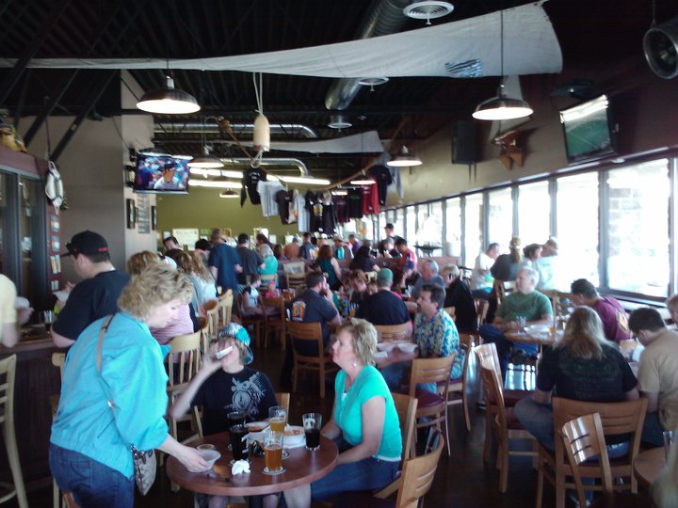
The Next Step: No More Pots and Pans
More space available in building
Started from scratch with buildout
Purchased “real” equipment
Hired a “real” brewer
On-time and under budget
Consistency
More seating
Filled the space immediately

Slide 15
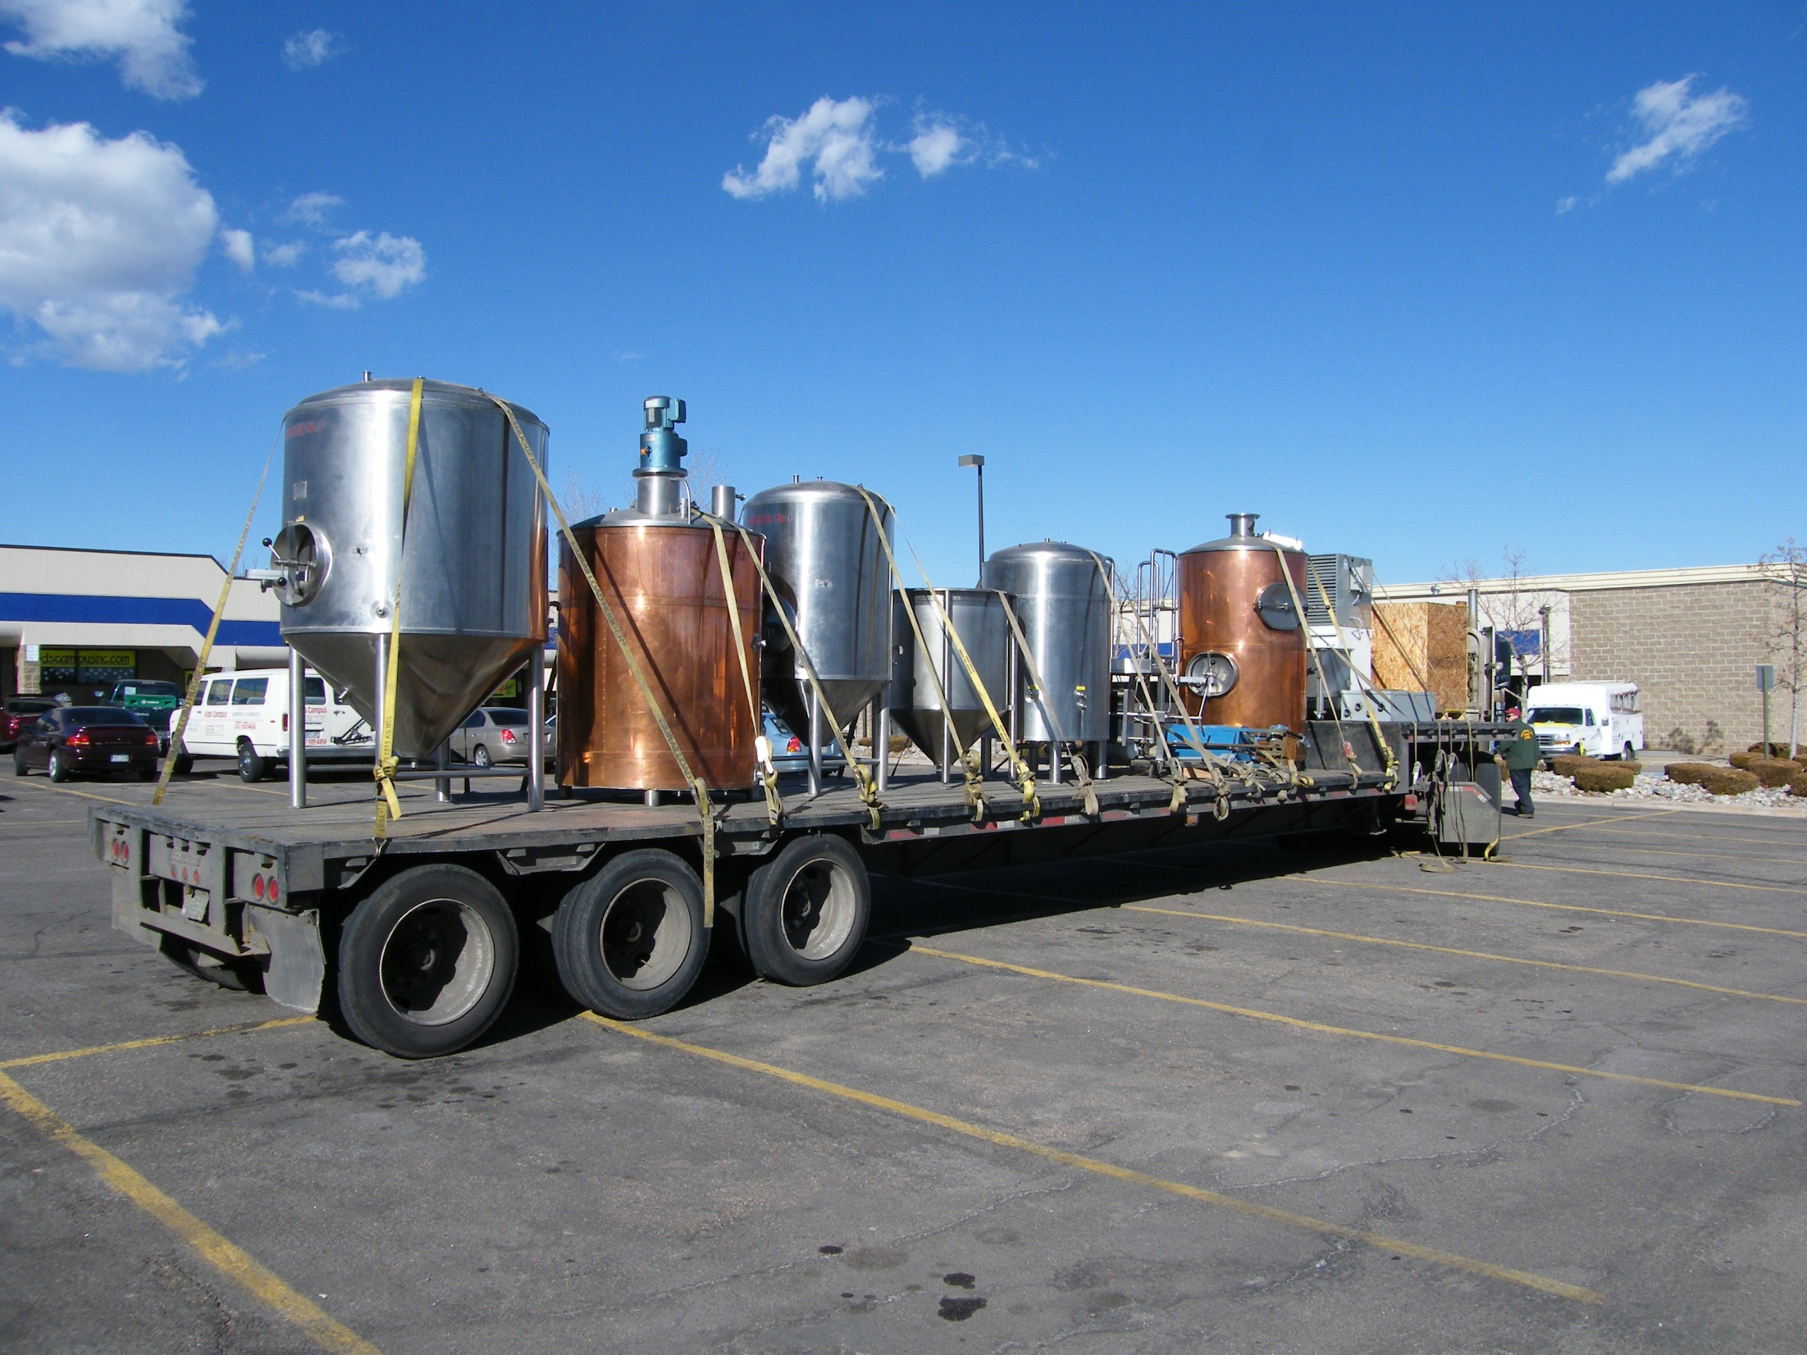

Slide 16
Continued Growth
January 2011 expansion
Moved The Brew Hut back to its original location
Increased seating to 170
Room for a Barrel Program
More fermenters and serving tanks
Started packaging and distributing

Slide 17
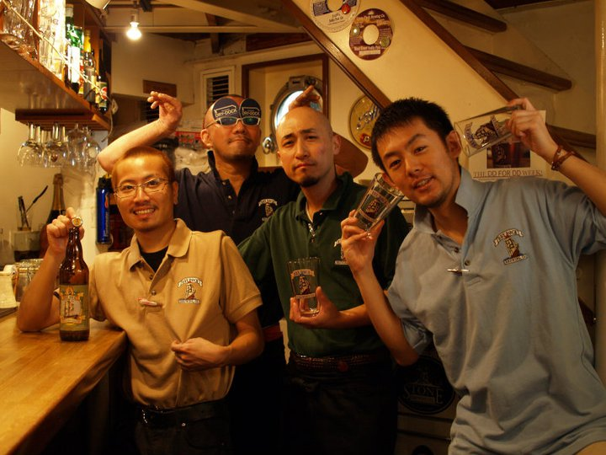
Dry Dock Today
2,400 – 3,000 barrels / year
Sales and distribution team
Tap accounts
  On premise accounts - 35
  Off premise accounts - 90
Overseas – Shimbashi
Dry-Dock, Tokyo
Reached capacity

Slide 18
Colorado: The Brewery Friendly State
Tasting room model (Manufacturer → Consumer)
2-tier vs. 3-tier (self-distribution)
No local liquor license
The way is paved
Mature homebrewing culture
Keeping it local
Currently, no chain-store sales

Slide 19
Increase in Breweries in Colorado
¹ According to the Brewers Association
² Thanks to Mike at Colorado Beer Mapping

Slide 20
Is This Sustainable?
Good beer and great location
Re-investment potential during growth
Proliferation
Legislative uncertainty
Packaging brewery is a different story

Slide 21
Questions?

